Slide 1
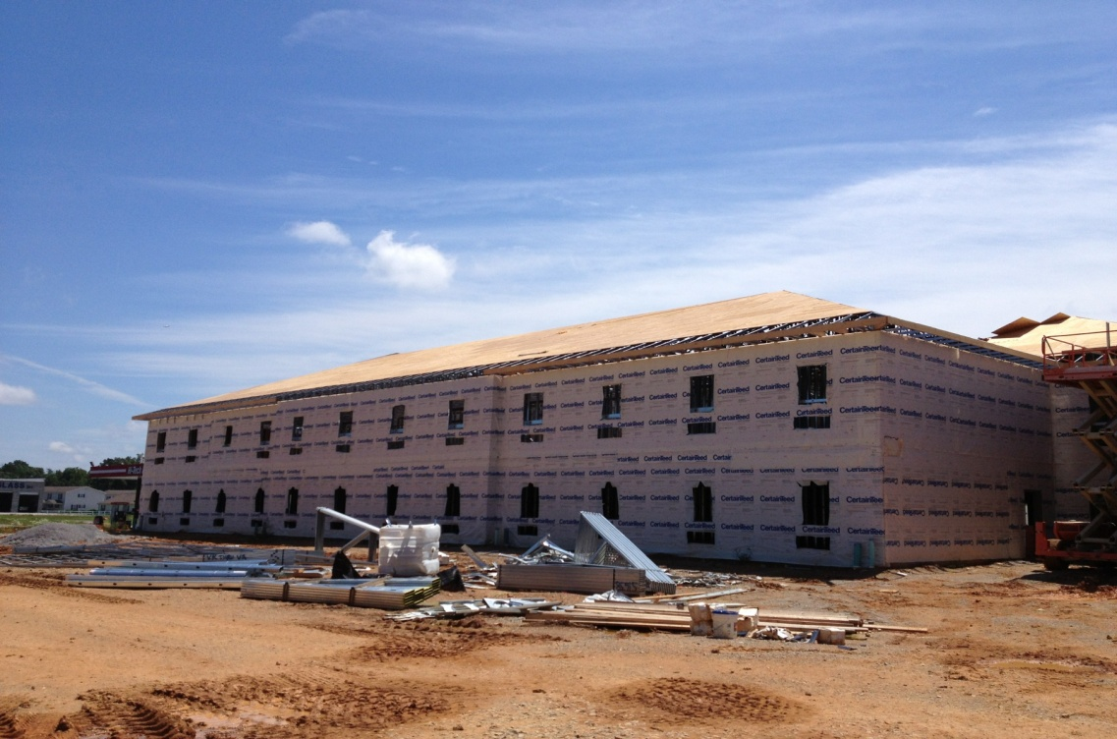
Oct. 7,2014
.

Slide 2
Don’t expect it, Earn it !!!
Your always Building…

Slide 3
Introduction to HAND TOOLS page 3.1

Slide 4
Agenda
2.0 Students will identify and demonstrate basic principles of safety procedures used in the construction industry.
6.0 Students will identify, select, inspect, safely use, maintain, and store hand tools
4.0 Students will trace the growth and development of the construction industry.
VOKI
POWERPOINT w/ Videos
Class Discussion
Hammer and Nail Performance Test.

Slide 5
What age, was the Hammer invented?

Slide 6
Stone Age….

Slide 7
Every profession has tools…
Surgeons use scalpels
Teachers use whiteboard, smart boards, projectors.
Accountant uses calculators.
Hair stylist use clippers.
What’s some other trades and tools?

Slide 8
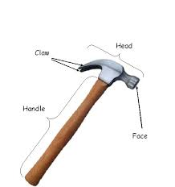
In Construction our most important tool is….
THE CLAW HAMMER

Slide 9
How to use a Claw Hammer…

Slide 10
BE SURE TO USE PROPER PPE.
Which is?

Slide 11
NAIL TEST

