Slide 1
Introduction to Hand Tools
Module 00103-04

Slide 2
Transparency 1
Objectives
Upon completion of this module, you will be able to do the following:
1. Recognize and identify some of the basic hand tools used in the construction trade.
2. Use hand tools safely.
3. Describe the basic procedures for taking care of hand tools.

Slide 3
Transparency 2
Performance Tasks
Under supervision of the instructor, you should be able to:
1. Visually inspect the following tools to determine if they are safe to use:
Hammer
Screwdriver
Saw
2. Make a straight square cut using a crosscut saw. To prepare for swing, the trainee should mark the wood with a combination square and support the work. The first stroke should be toward the trainee’s body. The saw should be kept vertical to the work.
3. Safely and properly use the following tools:
Hammer and cat’s paw (to drive and pull nails)
Screwdriver (slotted or Phillips)
Adjustable wrench
Tongue-and-groove pliers and adjustable wrench
Spirit level
Carpenter’s square and steel tape
Saw

Slide 4
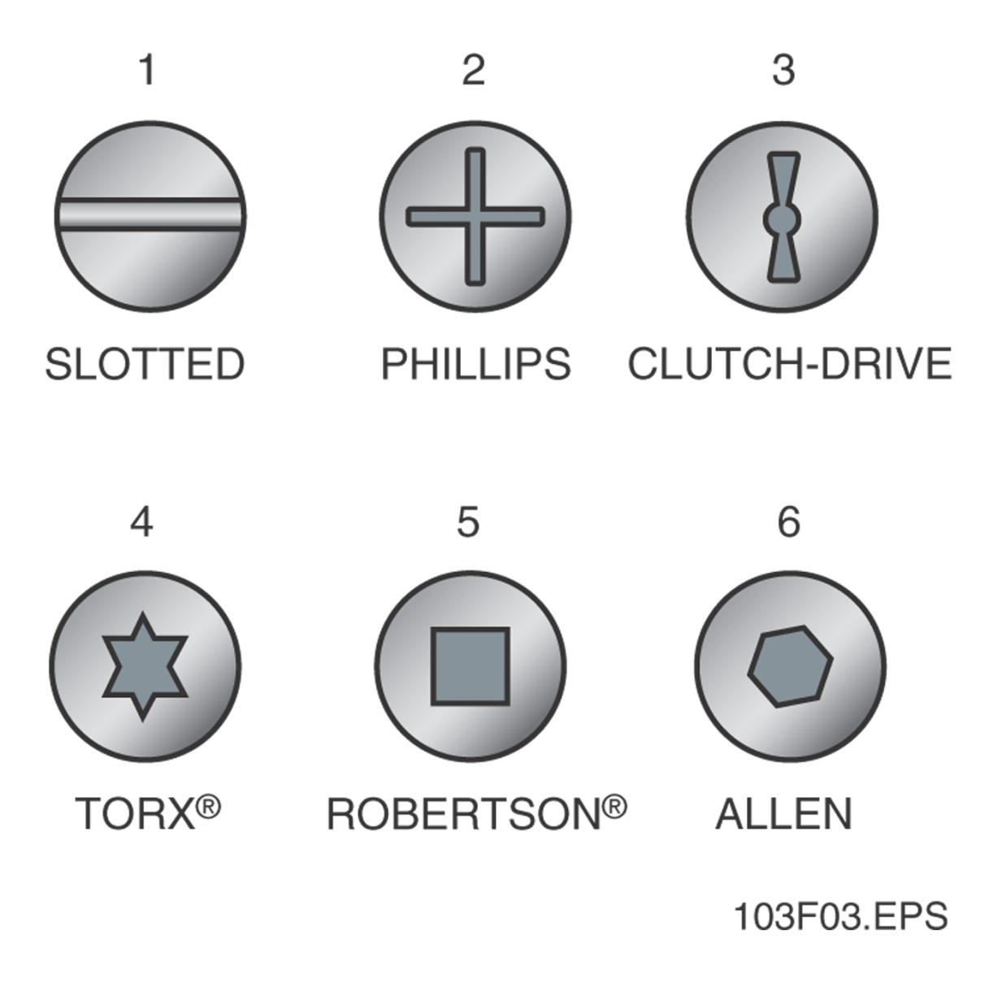
Transparency 3
Figure 3 - Six common types of screw heads

Slide 5
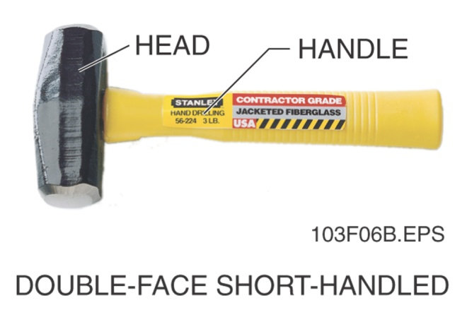
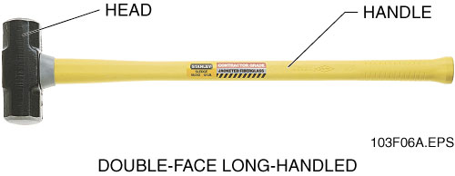
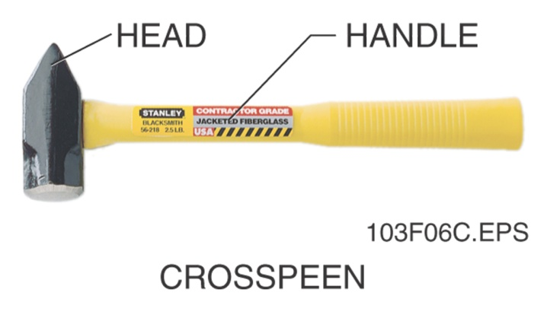
Transparency 4
Figure 6 - Types of sledgehammers

Slide 6
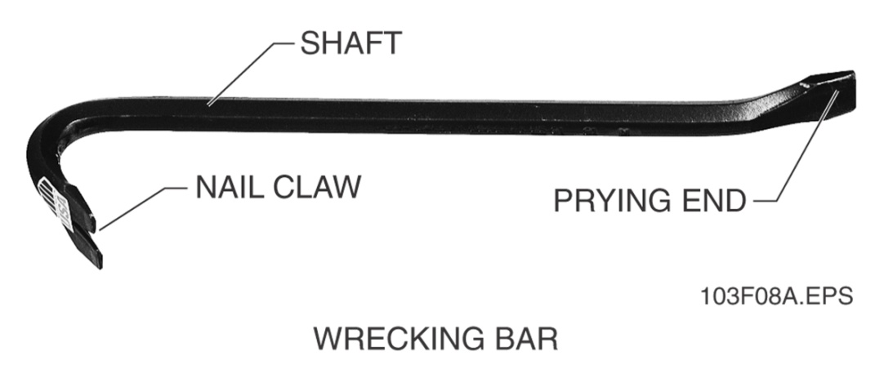
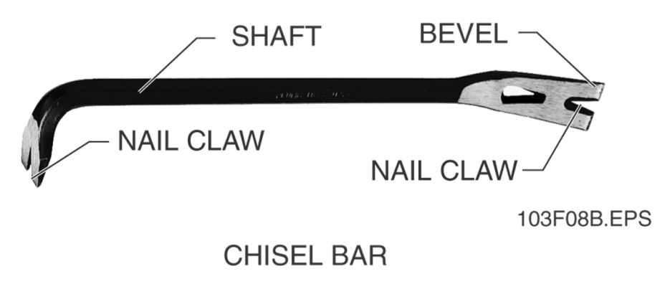
Transparency 5
Figure 8 - Ripping bars and nail pullers

Slide 7
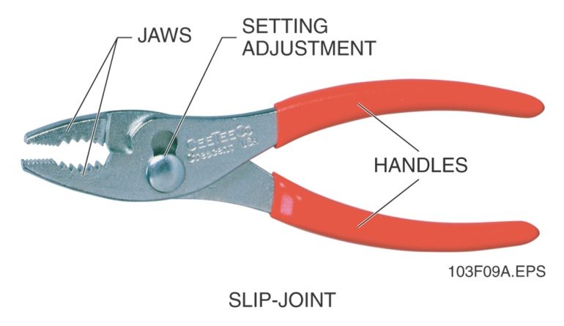
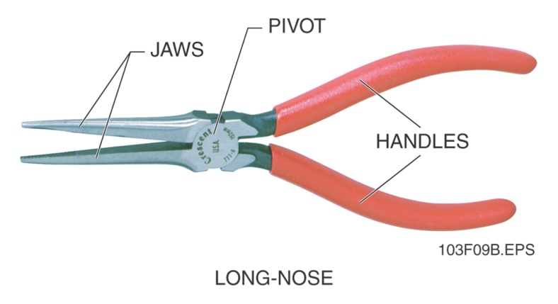
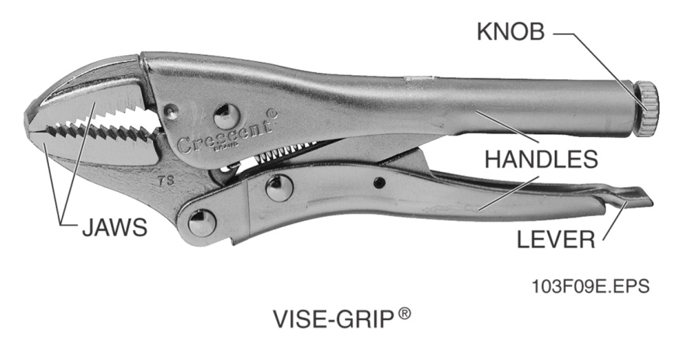
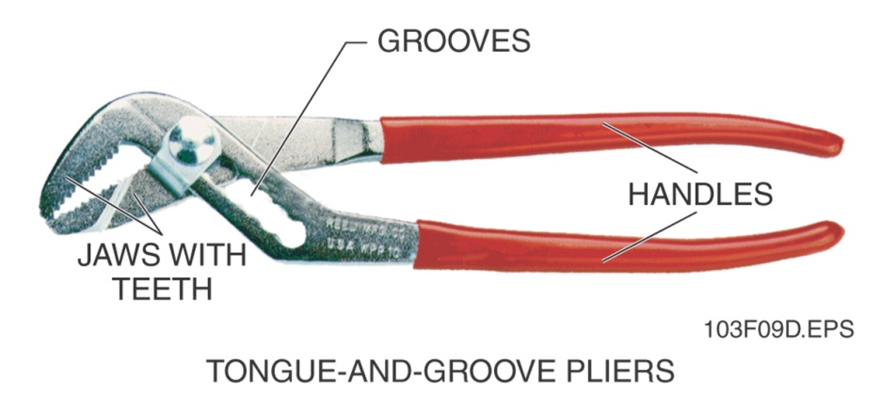
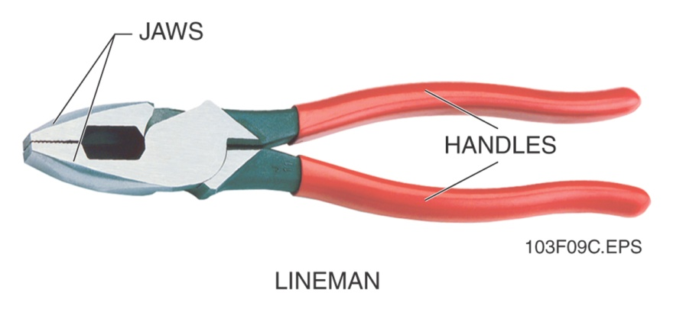
Transparency 6
Figure 9 - Types of pliers

Slide 8
Transparency 7
Figure 12 - Steel rule

Slide 9
Transparency 8
Figure 14 - Wooden folding rule

Slide 10
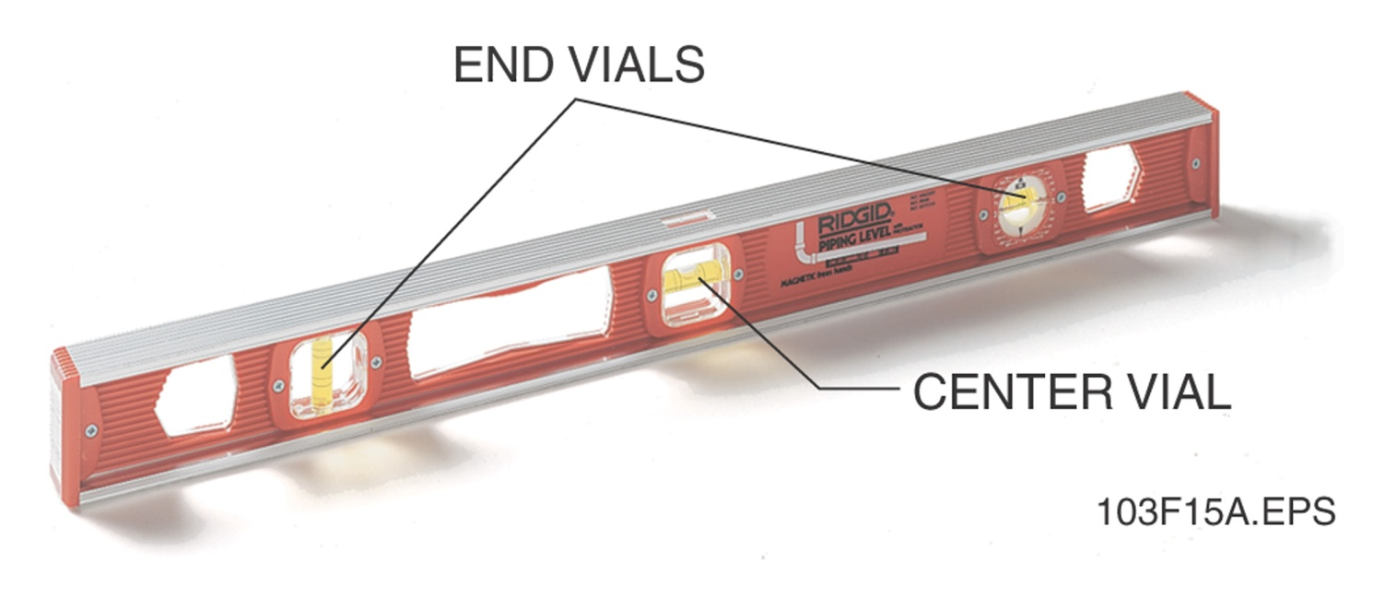
Transparency 9
Figure 15 - Spirit level

Slide 11
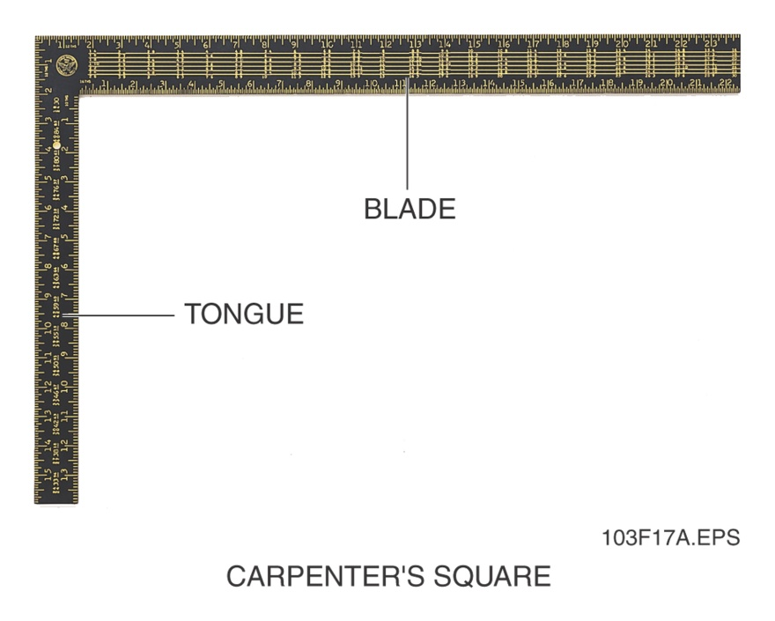
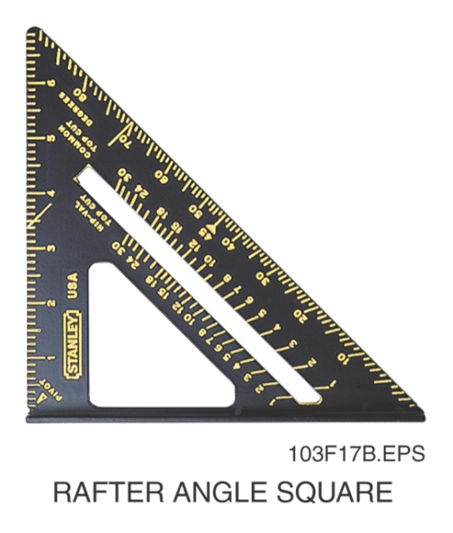
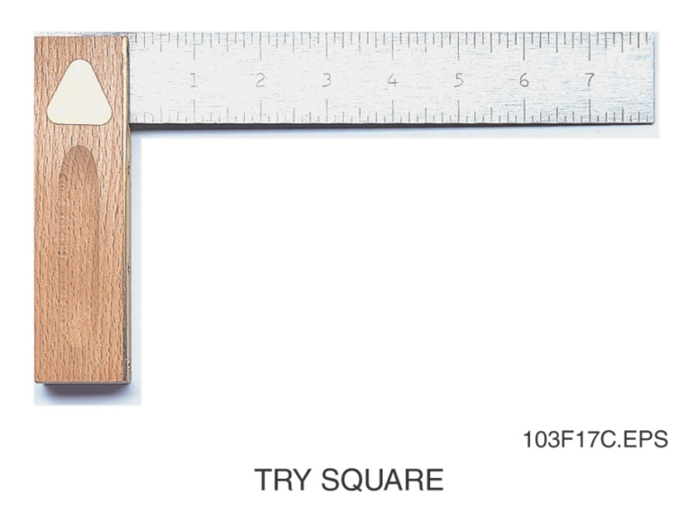
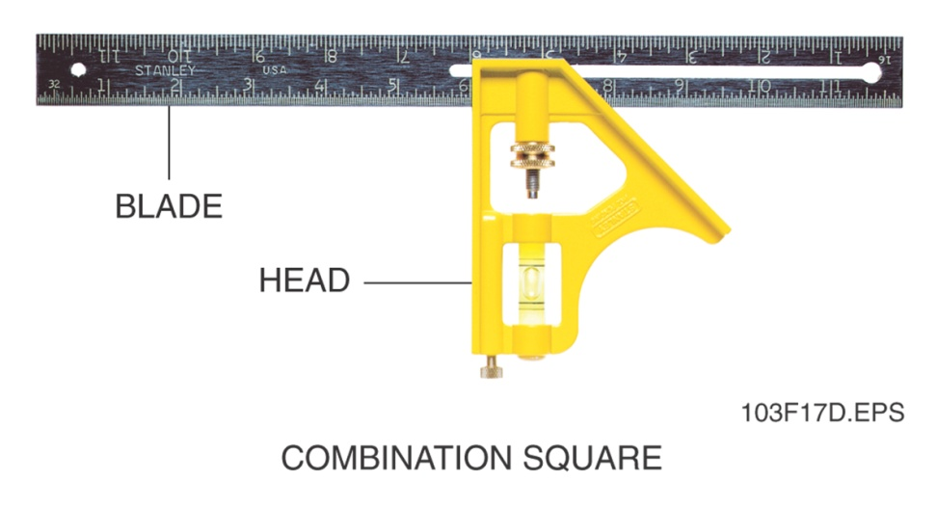
Transparency 10
Figure 17 - Types of squares

