Slide 1
Good Morning
Safety is Job #1

Slide 2
Introduction to Gypsum
1.4 : Demonstrate the ability to work cooperatively with others.
2.0 : Students will assume responsibility for the safety of themselves, their co-workers,and bystanders.
5.3 : Demonstrate proper use of hand tools, portable power tools, and stationary power tools.

Slide 3
Do you Know the answer to…

Slide 4
What was…
Gypsum/Drywall originally called?

Slide 5
Answer: Sackett Board

Slide 6
Sackett Board
Was invented in 1894 by Augustine Sackett and Fred Kane. It was made by layering plaster within four plies of wool felt paper. Sheets were 36" x 36" x 1/4" thick with open (untaped) edges.”

Slide 7
Gypsum Board
evolved between 1910 and 1930 beginning with wrapped board edges, and elimination of the two inner layers of felt paper in favor of paper-based facings. Providing efficiency of installation, it was developed additionally as a measure of fire resistance. Later air entrainment technology made boards lighter and less brittle, then joint treatment materials and systems also evolved.

Slide 8
DRYWALL
Drywall, also known as plasterboard or gypsum board, is a panel made of gypsum plaster pressed between two thick sheets of paper. It is used to make interior walls and ceilings

Slide 9
Plasterboard panels are also known as wallboard (USA, Ireland), Gibraltar board or GIB wall and ceiling linings (in New Zealand, trademark of Winstone Wallboards), rock lath, Sheetrock (a trademark of USG Corporation), Gyproc (in Australia, India and parts of Canada, a trademark of Compagnie de Saint-Gobain).
The sheets of the drywall can be made from fiberglass instead of paper to prevent mold growth. Mold growth is common when using paper-based plasterboard that has been exposed to water due to plumbing leaks or floods.
Drywall construction became prevalent as a speedier alternative to using plaster-based interior finish techniques, which involved forcefully spreading a substrate of coarse plaster, known as the base (made up of the scratch coat and (optional) brown coat), onto the wall's lath-work before finally applying the smoother finish coat, each layer added in succession and all by hand (see lath and plaster). Drywall, by contrast to plaster, requires hand finishing only at the fasteners and joints. The drywall process requires less labor and drying time, lending its name to the panels used in the assembly

Slide 10
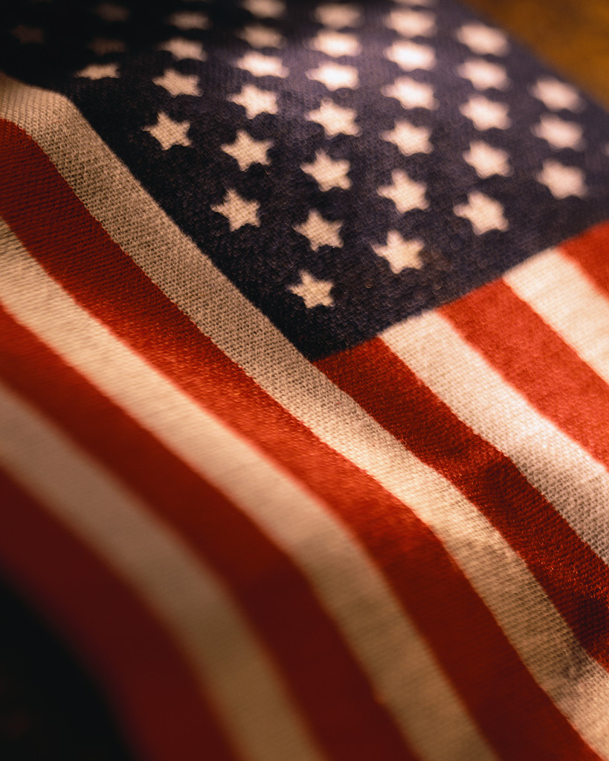
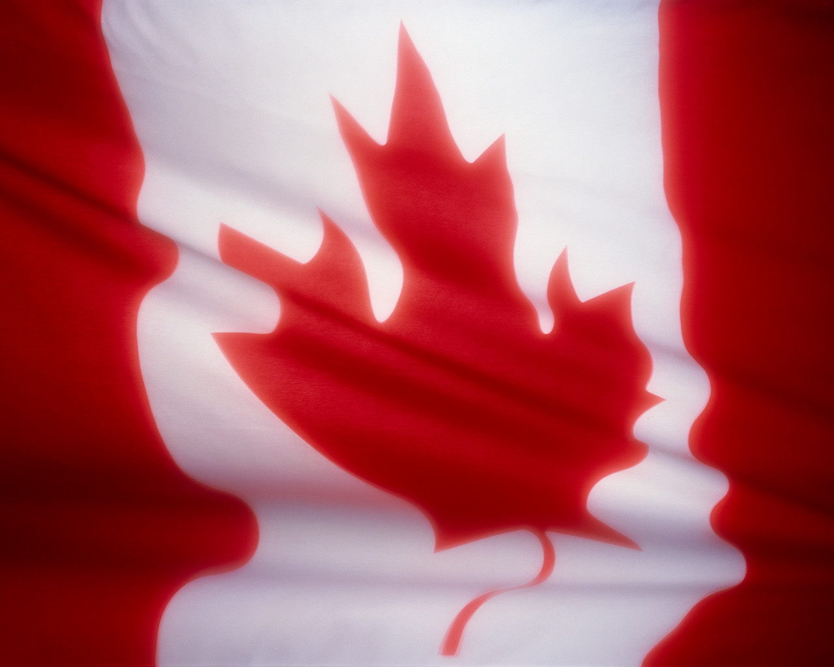
USA & cANADA

Slide 11
Drywall panels are manufactured in 48 inches (120 cm) and 54 inches (140 cm) wide panels in varying lengths to suit the application. Common panel thicknesses are 1/2" (12.7 mm) and 5/8" (16 mm), with panels also available in 1/4" (6 mm) and 3/8" (10 mm). Both 1/2" (12.7 mm) and 5/8" (16 mm) panels of TYPE 'X' (a gypsum board with special core additives to increase the natural fire resistance of regular gypsum board) are used where a fire-resistance rating is desired. Regular 5/8" (16 mm) panels are used (with or without light gauge resilient metal channels) where additional mass is needed for the reduction of sound transmission

Slide 12
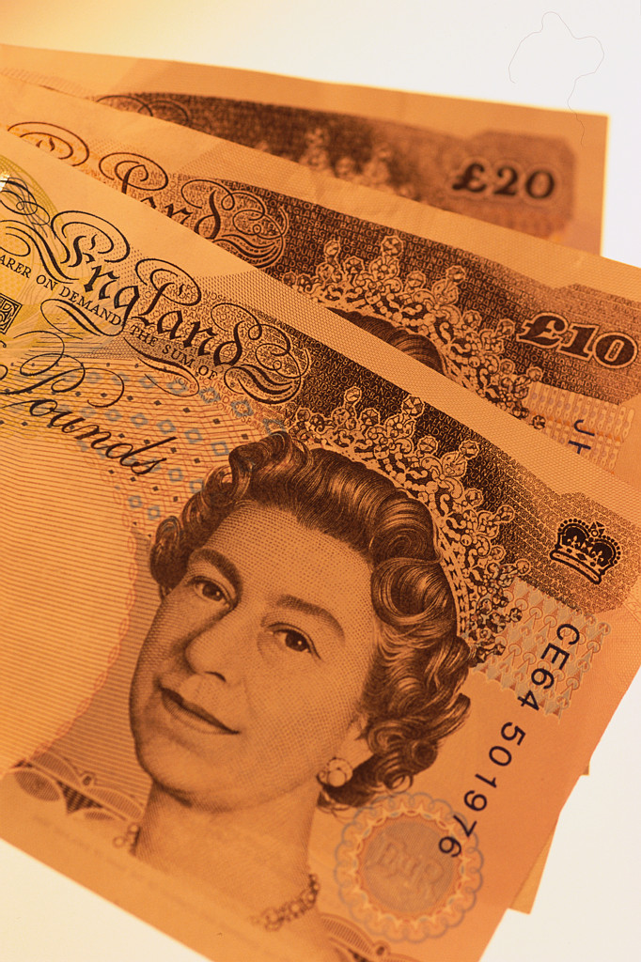
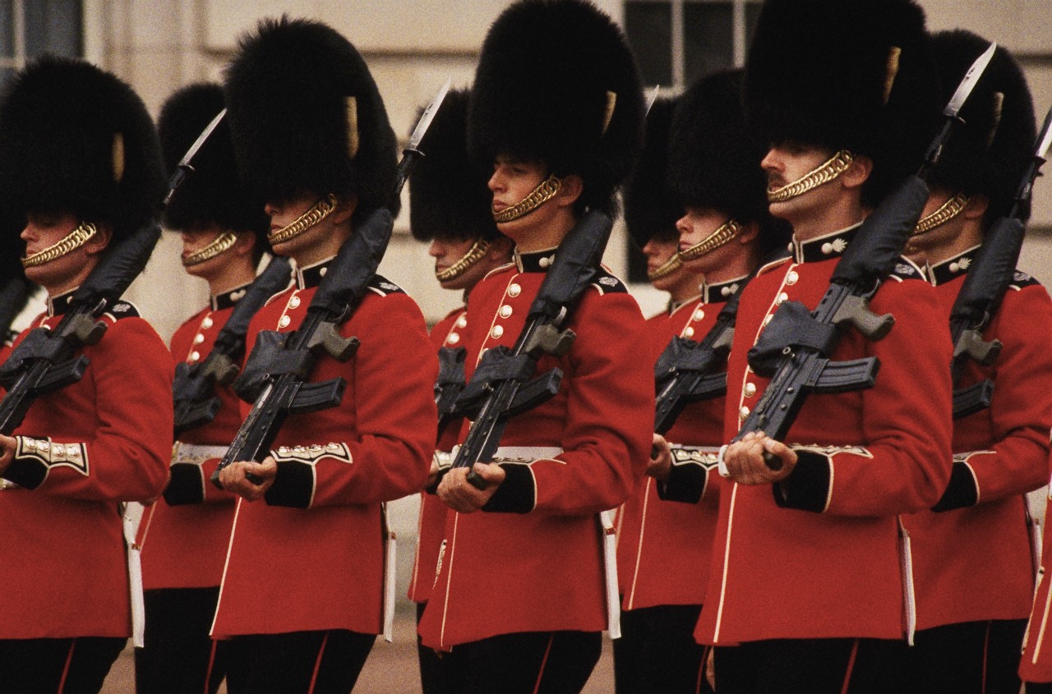
Uk & EUROPE

Slide 13
In the UK and Europe, plasterboard is manufactured in metric sizes, with the common sizes being corollaries of old imperial sizes.
Most plasterboard is made in 125 cm wide sheets, though 90 cm and 60 cm wide sheets are also made. 120 cm wide plasterboard is most commonly made in 240 cm lengths, though 270 cm and 300 cm length sheets are also commonly available

Slide 14
As opposed to a week-long plaster application, an entire house can be drywalled in one or two days by two experienced drywallers, and drywall is easy enough to use that it can be installed by many amateur home carpenters.

Slide 15
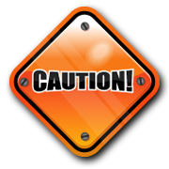
Drywall is easily damaged by exposure to water

Slide 16
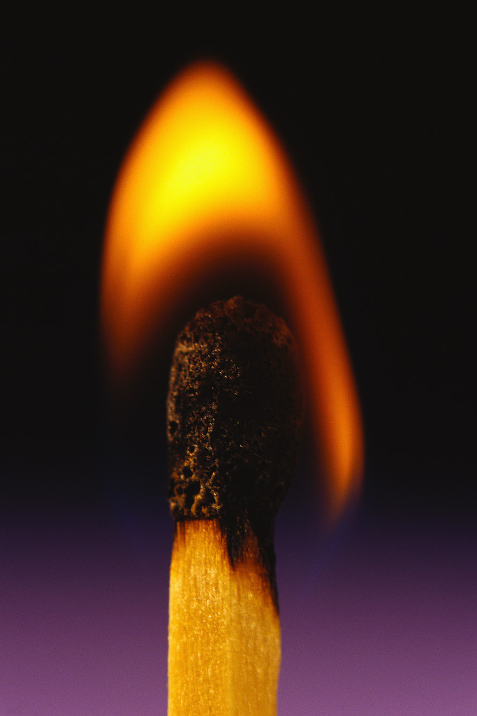
Fire prevention
When used as a component in fire barriers, drywall is a passive fire protection item. In its natural state, gypsum contains the water of crystallization bound in the form of hydrates. When exposed to heat or fire, this water is vapourised, retarding heat transfer. Therefore, a fire in one room that is separated from an adjacent room by a fire-resistance rated drywall assembly will not cause this adjacent room to get any warmer than the boiling point (100°C) until the water in the gypsum is gone.

Slide 17
Types of Drywall
Regular white board, from 1/4" to 3/4" thickness
Fire-resistant ("Type X"), different thickness and multiple layers of wallboard provide increased fire rating based on the time a specific wall assembly can withstand a standardized fire test. Often perlite, vermiculite and boric acid are added to improve fire resistance.
Greenboard, the drywall that contains an oil-based additive in the green colored paper covering that provides moisture resistance. It is commonly used in washrooms and other areas expected to experience elevated levels of humidity. [1]
Blueboard, blue face paper forms a strong bond with a skim coat or a built-up plaster finish providing both water and mold resistance.
Cement board, which is more water-resistant than greenboard, for use in showers or sauna rooms, and as a base for ceramic tile
Soundboard is made from wood fibers to increase the sound rating (STC)
Soundproof drywall is a laminated drywall made with gypsum, other materials, and damping polymers to significantly increase the STC^{[citation needed]}
Mold-resistant, paperless drywall^{[citation needed]}
Enviroboard, a board made from recycled agricultural materials
Lead-lined drywall, a drywall used around radiological equipment^{[citation needed]}
Foil-backed drywall to control moisture in a building or room^{[citation needed]}
Controlled density (CD), also called ceiling board, which is available only in 1/2" thickness and is significantly stiffer than regular white board.
EcoRock, a drywall which uses a combination of 20 materials including recycled fly ash, slag, kiln dust and fillers and no starch cellulose; it is advertised as being environmentally-friendly due to the use of recycled materials and an energy efficient process.^{[18]}
Gypsum “Firecode C.” This board is similar in composition to Type X, except for more glass fibers and a form of vermiculite, used to reduce shrinkage. When exposed to high heat, the gypsum core shrinks but this additive expands at about the same rate, so the gypsum core is more stable in a fire, and remains in place even after the gypsum dries up

Slide 18
Common Tools
Benches
Chalk line
Corner trowel
Drywall adhesive glue guns
Drywall cart
Drywall fastener
Drywall (hatchet) hammer
Drywall lifter
Drywall jack
Drywall screws and nails
Electric screwdriver
Keyhole saw or drywall router
Pencil
Screw gun
Stud finder
Tape measure
Taping knife
T-square
Utility knife

Slide 19
questions ?

